Slide 1


Interrelationships Between Open-Source, Proprietary, & Machine Learning-Derived Accelerometry Metrics
Slides available on Whova and GitHub:
https://github.com/chriscmoore/Slides_ICAMPAM-2022
Christopher Moore
Doctoral Student
Department of Epidemiology

Slide 2
Disclosures: Christopher Moore
No relevant financial relationships or conflicts of interest for this presentation

Slide 3
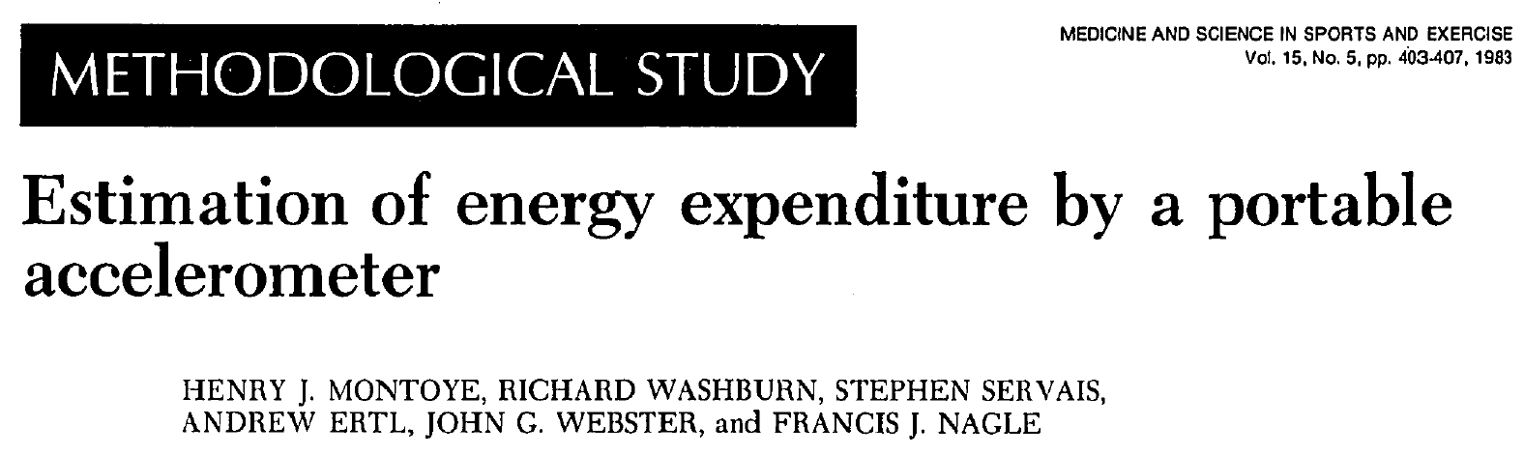




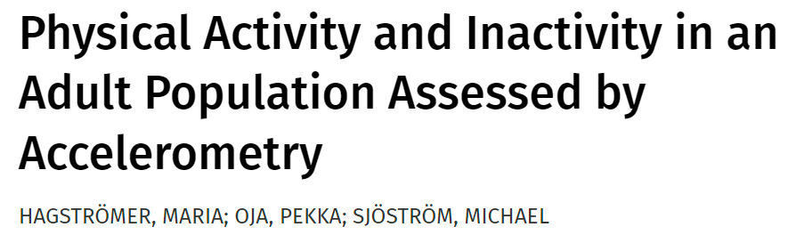

Evolution of Physical Behavior (PB) Assessment
Accelerometry for physical behavior (PB) assessment
Initially developed in the 1980s
Now feasible for PB assessment in large samples¹
[UK]
[in Sweden]
Lee et al., J Meas Phys Behav 2018

Slide 4
Limitations of Activity Counts
However, activity counts:
Derived from a proprietary algorithm
Differ across devices
Interpreted using device- and population-specific cutpoints
Activity counts
Steps
Barrier to harmonizing accelerometer data/results for:¹
Cross-population PB surveillance
More generalizable and statistically powerful longitudinal studies
Examining trends over time
Wijndaele et al., Med Sci Sports Exerc 2015

Slide 5
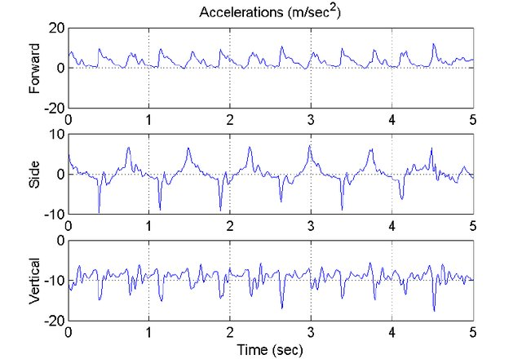
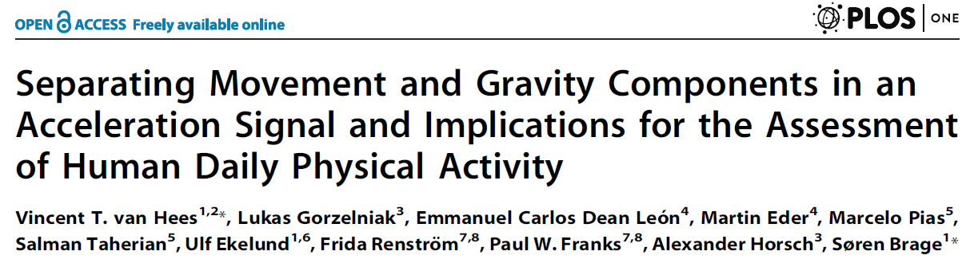
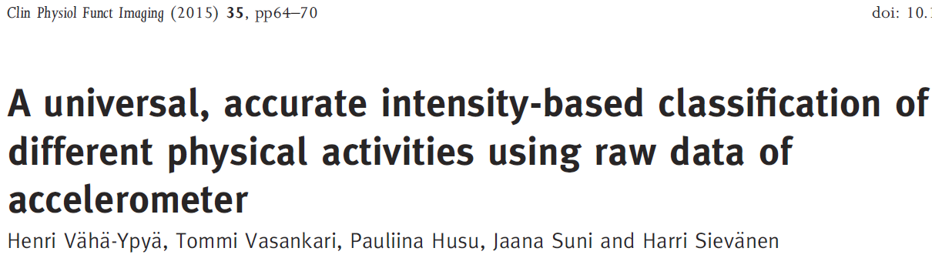
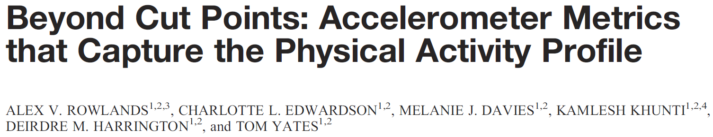
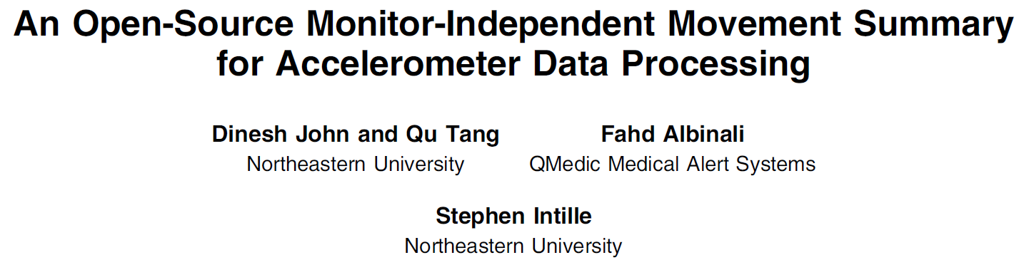
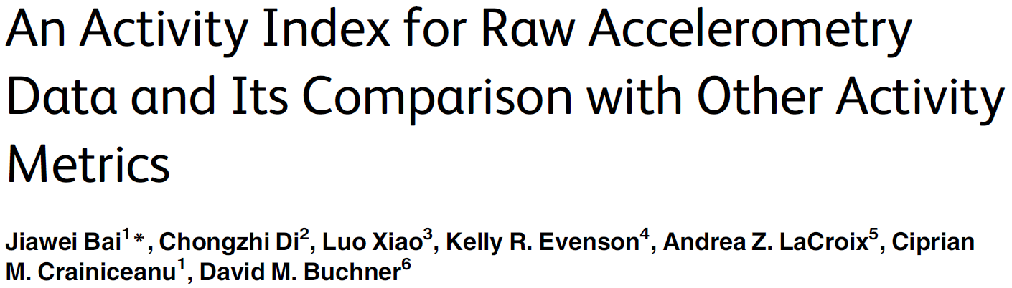
Raw Data & Open-Source Algorithms
(2013)
(2018)
(2019)
(2016)

Slide 6
Raw Data & Open-Source Algorithms
(2013)
Several methods now available for processing raw data
Potential barrier to harmonizing accelerometer data/results for:¹⁻³
Cross-population PB surveillance
More generalizable and statistically powerful longitudinal studies
Examining trends over time
¹Troiano et al., Br J Sports Med, 2014
²Wijndaele et al., Med Sci Sports Exerc, 2015
³Van Hees et al., Methods Inf Med, 2016
(2018)
(2019)
(2016)

Slide 7

Purpose
To evaluate correlations among a variety of accelerometer metrics evaluated in the same free-living data
Metric/method |  | Reference
Vector magnitude activity counts | VM counts | Evenson et al., Prev Med Rep 2015
Euclidean Norm Minus One | ENMO | Van Hees et al., PLoS One 2013
Mean amplitude deviation | MAD | Vaha-Ypya et al., Clin Physiol Funct 2015
Accelerometer Activity Index | AAI | Bai et al., PLoS One 2016
Monitor-Independent Movement Summary | MIMS | John et al., J Meas Phys Behav 2019
Two-level behavioral classification | TLBC | Ellis et al., Med Sci Sports Exerc 2016
Open-source single-unit summaries
Data-driven (machine-learned) classification algorithm

Slide 8
Methods

Slide 9
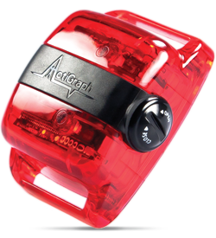
Participants
Women’s Health Study (WHS)
1992 – 2004
Randomized trial
(n = 39,876)
Female health professionals ≥45 years
2004
Observational cohort
(n = 33,682)
2011-2015
Ancillary cohort
(n = 18,289)
Randomly selected n=100
Mailed an accelerometer

Slide 10
Measures: Exposure
ActiGraph GT3X+ accelerometer¹
Hip-worn for 7 days
Removed only for sleep and water-based activities
Sampled at 30 Hz
Adherent days: ≥10 wear hours
Nonwear identified with wear logs and Choi algorithm²
Used to derive accelerometry metrics at the 5-sec-, minute-, and day-level
1) Lee et al. Circulation 2018
2) Choi et al. Med Sci Sports Exerc 2011

Slide 11
5-Sec-Level Metrics
Metrics derived at the 5-sec-level
Open-source single-unit summaries
Metric | Description | R Package | Reference
ENMO | Square root of the sum of squared axis-specific accelerations, minus 1g (gravity) | `GGIR`* | Van Hees et al., PLoS One 2013
MAD | Average absolute distance between observed and the mean acceleration for a given epoch | `GGIR`* | Vaha-Ypya et al., Clin Physiol Funct 2015
AAI | Sum of the axis-specific variances normalized using the systematic noise variance | `ActivityIndex` | Bai et al., PLoS One 2016
MIMS | Additive aggregation of axis-specific acceleration AUCs after interpolation, extrapolation, and bandpass filtering | `MIMSunit` | John et al., J Meas Phys Behav 2019
* GGIR also used for auto-calibration

Slide 12
Minute-Level Metrics
Metric/method |  | 5-sec-level
Open-source units
 | MAD | ü
 | ENMO | ü
 | AAI | ü
 | MIMS | ü
Metric/method |  | 5-sec-level | Minute-level
Open-source units
 | MAD | ü | ü
 | ENMO | ü | ü
 | AAI | ü | ü
 | MIMS | ü | ü
VM activity counts
 | Total Counts |  | ü
5-sec epochs averaged over 1 minute
Activity counts exported in 1-minute epochs

Slide 13
Day-Level Metrics
Metric/method |  | 5-sec-level | Minute-level
Open-source units
 | MAD | ü | ü
 | ENMO | ü | ü
 | AAI | ü | ü
 | MIMS | ü | ü
VM activity counts
 | Total Counts |  | ü
Metric/method |  | 5-sec-level | Minute-level | Day-level
Open-source units
 | MAD | ü | ü | ü
 | ENMO | ü | ü | ü
 | AAI | ü | ü | ü
 | MIMS | ü | ü | ü
VM activity counts
 | Total Counts |  | ü | ü
 | Sedentary time |  |  | ü
 | Light low PA |  |  | ü
 | Light high PA |  |  | ü
 | MVPA |  |  | ü
TLBC algorithm
 | Sitting |  |  | ü
 | Riding in vehicle |  |  | ü
 | Standing still |  |  | ü
 | Standing/moving |  |  | ü
5-sec epochs averaged over 1 day
VM activity counts
TLBC algorithm

Slide 14
Day-Level Metrics
Metric | VM counts/15 sec
Sedentary time | 0-18
Light low PA | 19-225
Light high PA | 226-518
MVPA | ≥519
VM activity counts
VM activity counts
Total counts/d
Min/d in activity intensities¹
TLBC algorithm (two-level behavioral classification)²
Initial classification via random forest algorithm
Smoothing of transitions via hidden Markov model
TLBC behavior categories
Sitting
Standing still
Standing, moving
Walking/running
Riding in a vehicle
TLBC algorithm
1) Evenson et al., Prev Med Rep 2015
2) Ellis et al. Med Sci Sports Exerc 2016

Slide 15
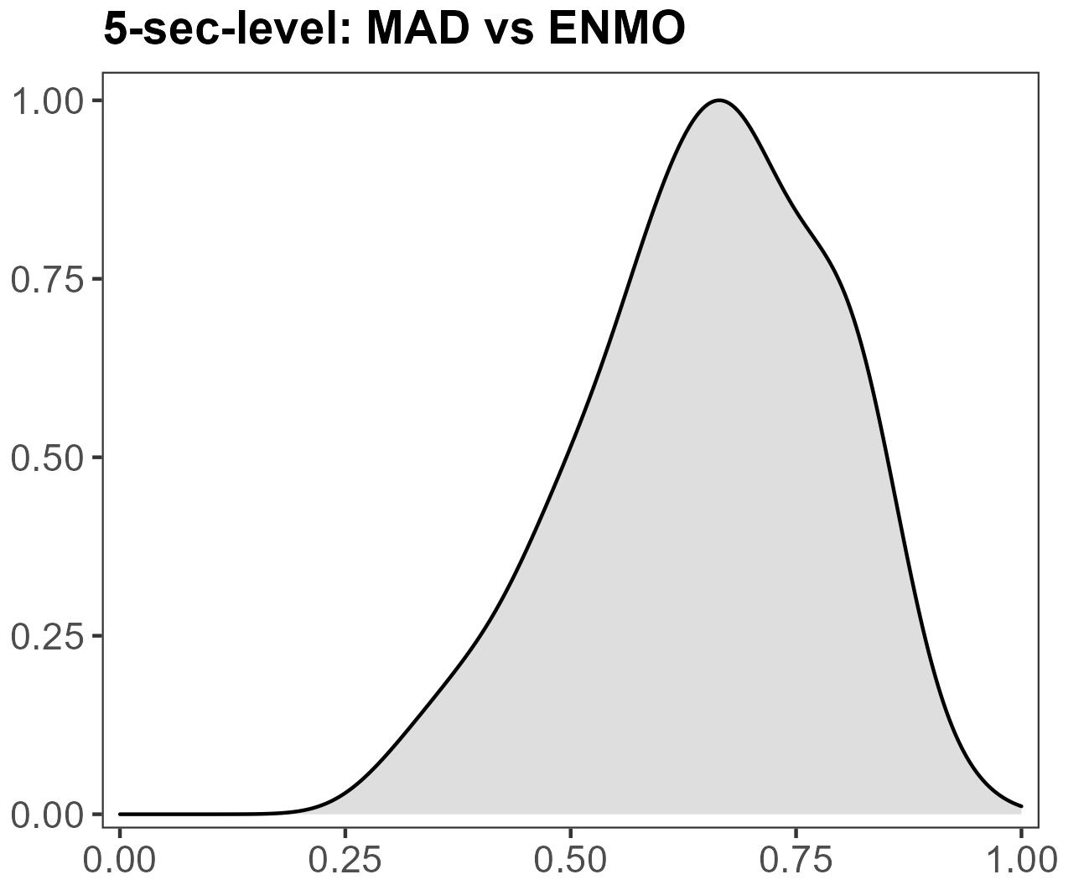
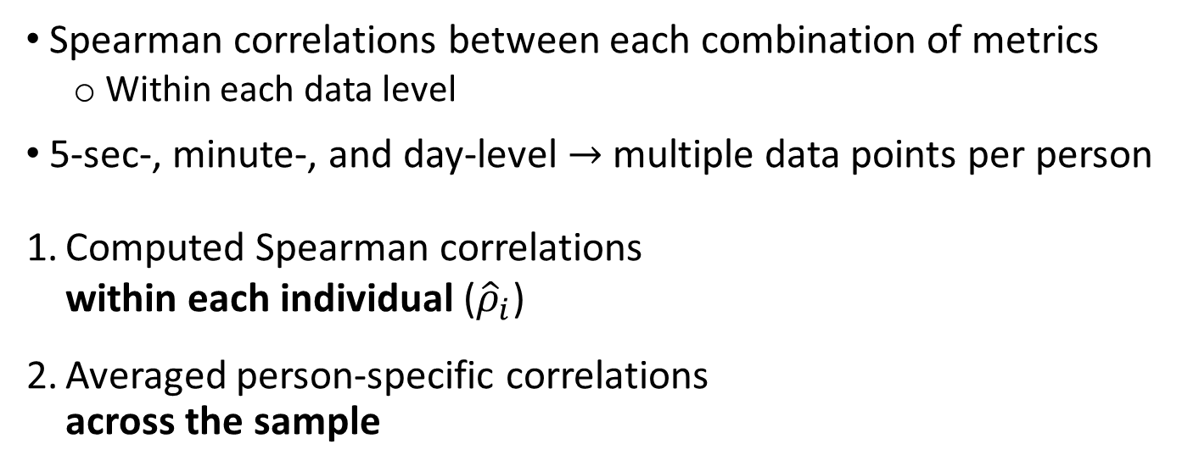
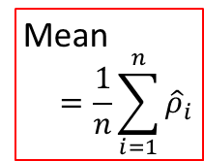
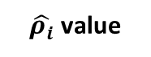
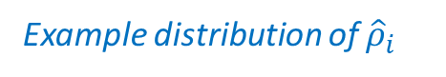
No steps/d in bouts
1-2000 steps/d in bouts
>2000 steps/d in bouts
Statistical Analyses
Spearman correlations between each combination of metrics
Within each data level
5-sec-, minute-, and day-level → multiple data points per person
Computed Spearman correlations
within each individual (${\hat{ρ}}_{i}$)
Averaged person-specific correlations
across the sample
Example distribution of ${\hat{ρ}}_{i}$
Mean
$$=\frac{1}{n}\sum_{i=1}^{n}{{\hat{ρ}}_{i}}$$
Density
R version 3.6.3 (R Foundation for Statistical Computing, Vienna, Austria)
$\hat{ρ_{i}}$ value

Slide 16
Results

Slide 17
Sample Characteristics (n = 100)
Characteristic | Mean (SD) or %
Age (years) | 71.0 (5.3)
Wear hours/day | 14.9 (1.2)
Adherent days | 6.8 (0.6)
BMI (kg/m²) | 26.0 (5.5)
White, non-Hispanic | 89.0%
Smokers | 6.0%
Alcohol use | 57.0%
History of CVD | 1.0%
History of cancer | 9.0%

Slide 18
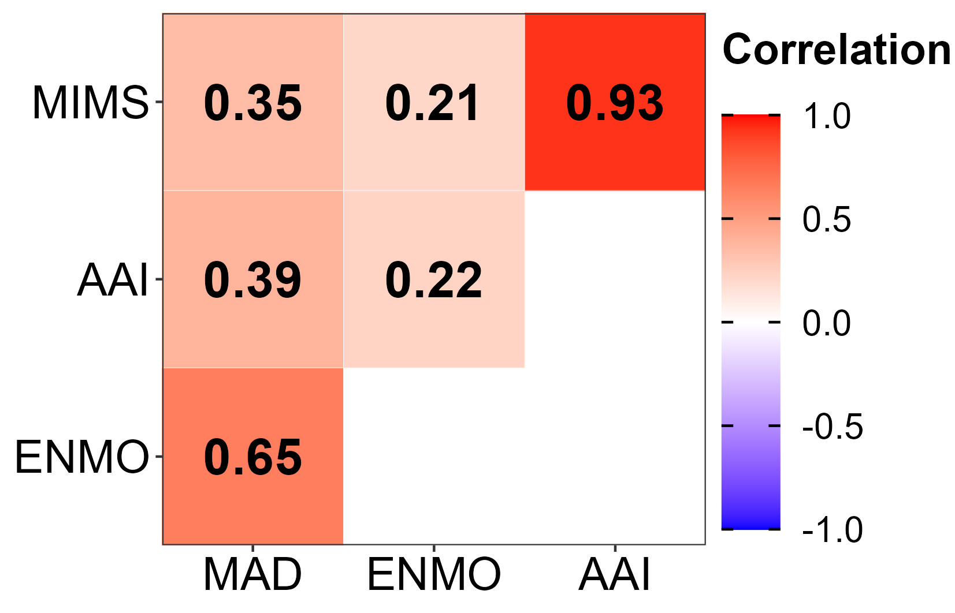
Results: 5-Second-Level
Mean Spearman correlations at the 5-sec-level

Slide 19
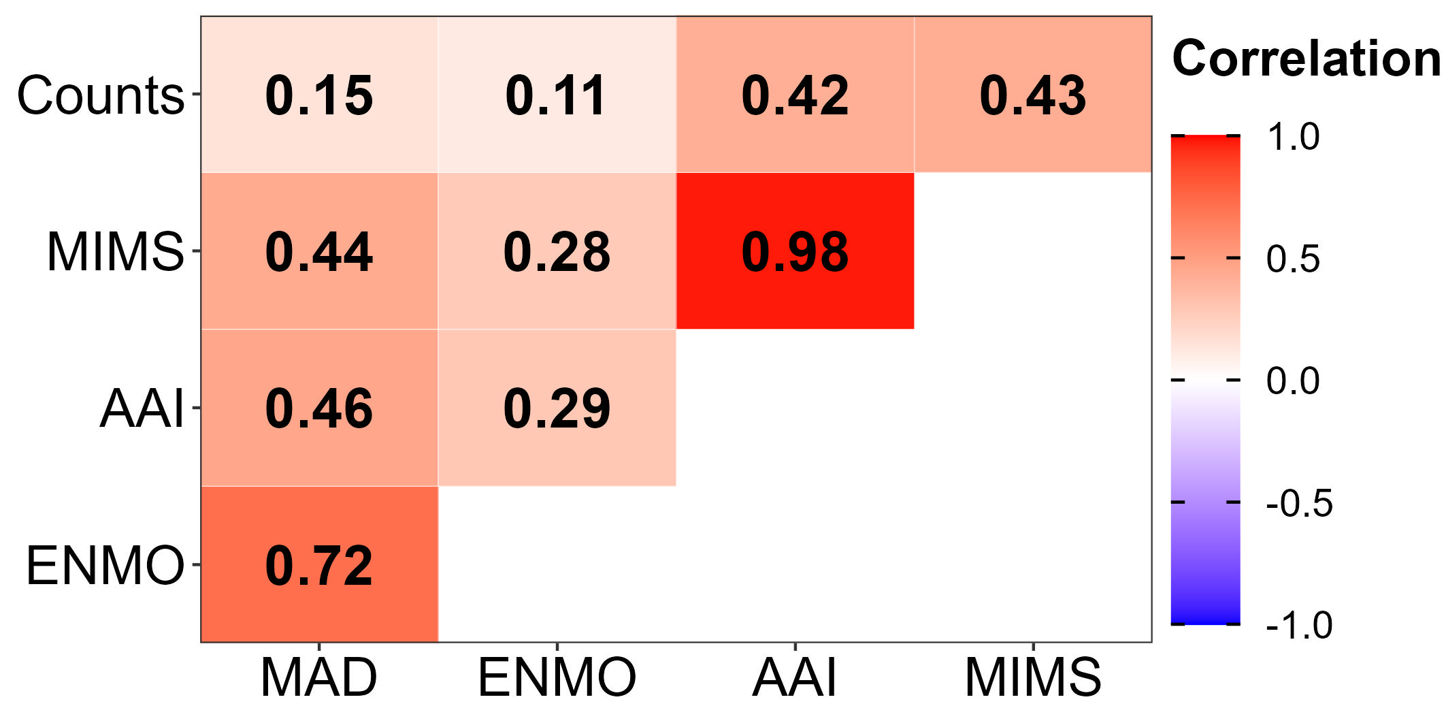
Results: Minute-Level
Mean Spearman correlations at the minute-level
Mean Spearman correlations at the 5-sec-level

Slide 20
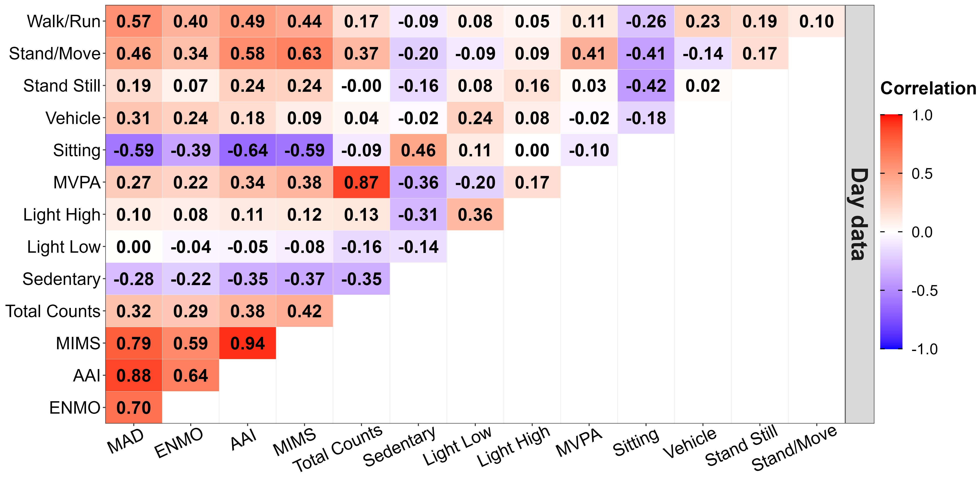
Results: Day-Level
Mean Spearman correlations at the day-level
Open-source units
Activity counts
TLBC

Slide 21
Discussion & Conclusions

Slide 22
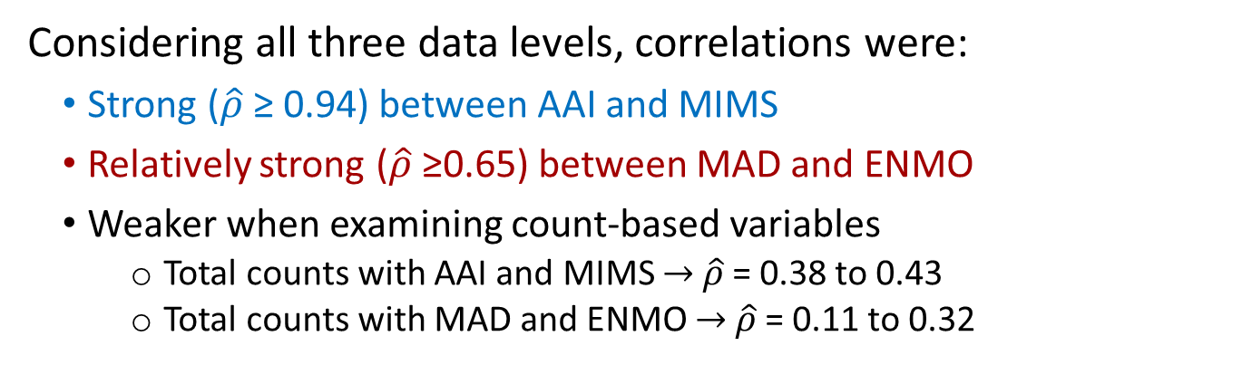
Summary
Considering all three data levels, correlations were:
Strong ($\hat{ρ}$≥ 0.94) between AAI and MIMS
Relatively strong ($\hat{ρ}$≥0.65) between MAD and ENMO
Weaker when examining count-based variables
Total counts with AAI and MIMS → $\hat{ρ}$= 0.38 to 0.43
Total counts with MAD and ENMO → $\hat{ρ}$= 0.11 to 0.32
5-sec-level
Minute-level
Day-level

Slide 23
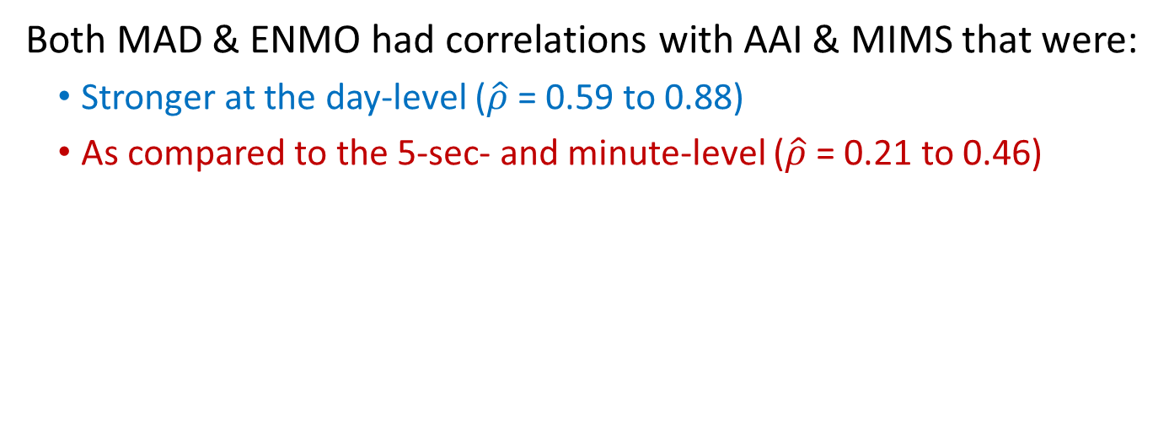
Summary (cont.)
Both MAD & ENMO had correlations with AAI & MIMS that were:
Stronger at the day-level ($\hat{ρ}$= 0.59 to 0.88)
As compared to the 5-sec- and minute-level ($\hat{ρ}$= 0.21 to 0.46)
5-sec-level
Minute-level
Day-level

Slide 24
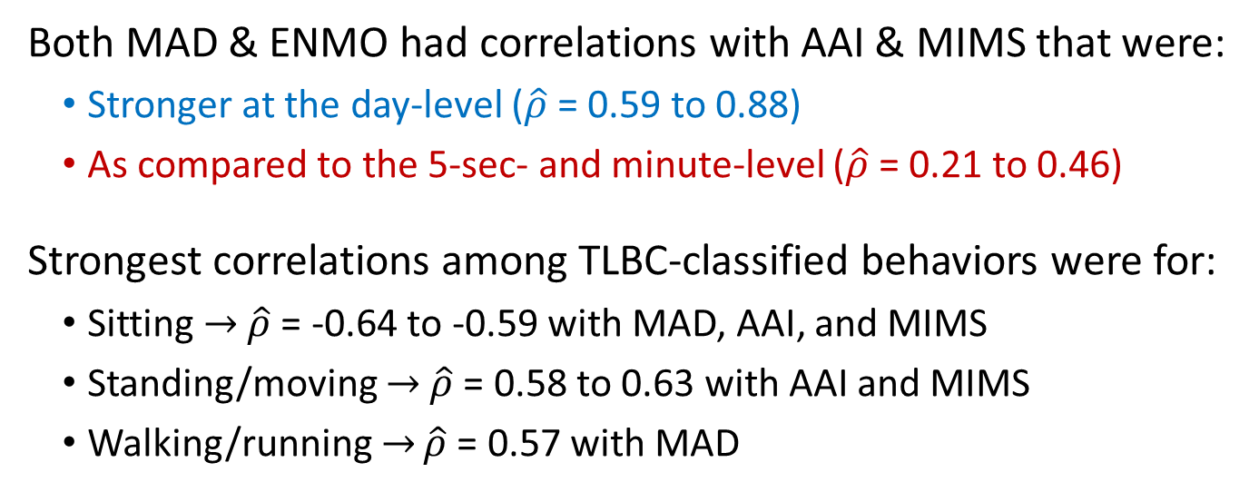
Summary (cont.)
Both MAD & ENMO had correlations with AAI & MIMS that were:
Stronger at the day-level ($\hat{ρ}$= 0.59 to 0.88)
As compared to the 5-sec- and minute-level ($\hat{ρ}$= 0.21 to 0.46)
Strongest correlations among TLBC-classified behaviors were for:
Sitting → $\hat{ρ}$= -0.64 to -0.59 with MAD, AAI, and MIMS
Standing/moving → $\hat{ρ}$= 0.58 to 0.63 with AAI and MIMS
Walking/running → $\hat{ρ}$= 0.57 with MAD
TLBC behavior:
→ Comprises part of the day
Open source units:
→ Averaged over entire day

Slide 25
Limitations
Generalizability
Sample of 100 older (predominately non-Hispanic white) women
ActiGraph GT3X+ accelerometer
Open-source unit metrics examined in their original continuous units of measure (e.g., mg)
May not reflect how they are ultimately used in studies aimed to inform public health guidelines
No other types of measures for further assessing validity
E.g., calorimetry, doubly-labelled water, or direct observation

Slide 26
Future Directions
Include additional metrics derived from raw accelerometer data
Intensity gradient¹, most active 30 minutes²
CNN Hip Accelerometer Posture (CHAP)³
Examine how observed differences may impact relationships with health outcomes
Explore why and where these differences exist
e.g., through more controlled (laboratory-based) studies
Provide recommendations for researchers
Or creating a consensus on how recommendations should be informed
Rowlands et al., Med Sci Sports Exerc 2018
Rowlands et al., J Sci Med Sport 2019
Greenwood-Hickman et al. Med Sci Sports Exerc 2021

Slide 27
Acknowledgements
Co-authors:
Kelly R. Evenson, PhD – UNC Chapel Hill
Eric J. Shiroma, PhD - National Institute on Aging
Carmen C. Cuthbertson, PhD – UNC Chapel Hill
Julie E. Buring, ScD – Brigham and Women’s Hospital; Harvard Medical School
I-Min Lee, ScD – Brigham and Women’s Hospital; Harvard Medical School
Funding:
CVD Epidemiology T32 Training Grant (NRSA: T32-HL007055-44)
NIH grants CA154647, CA047988, CA182913, HL043851, HL080467, HL099355

Slide 29
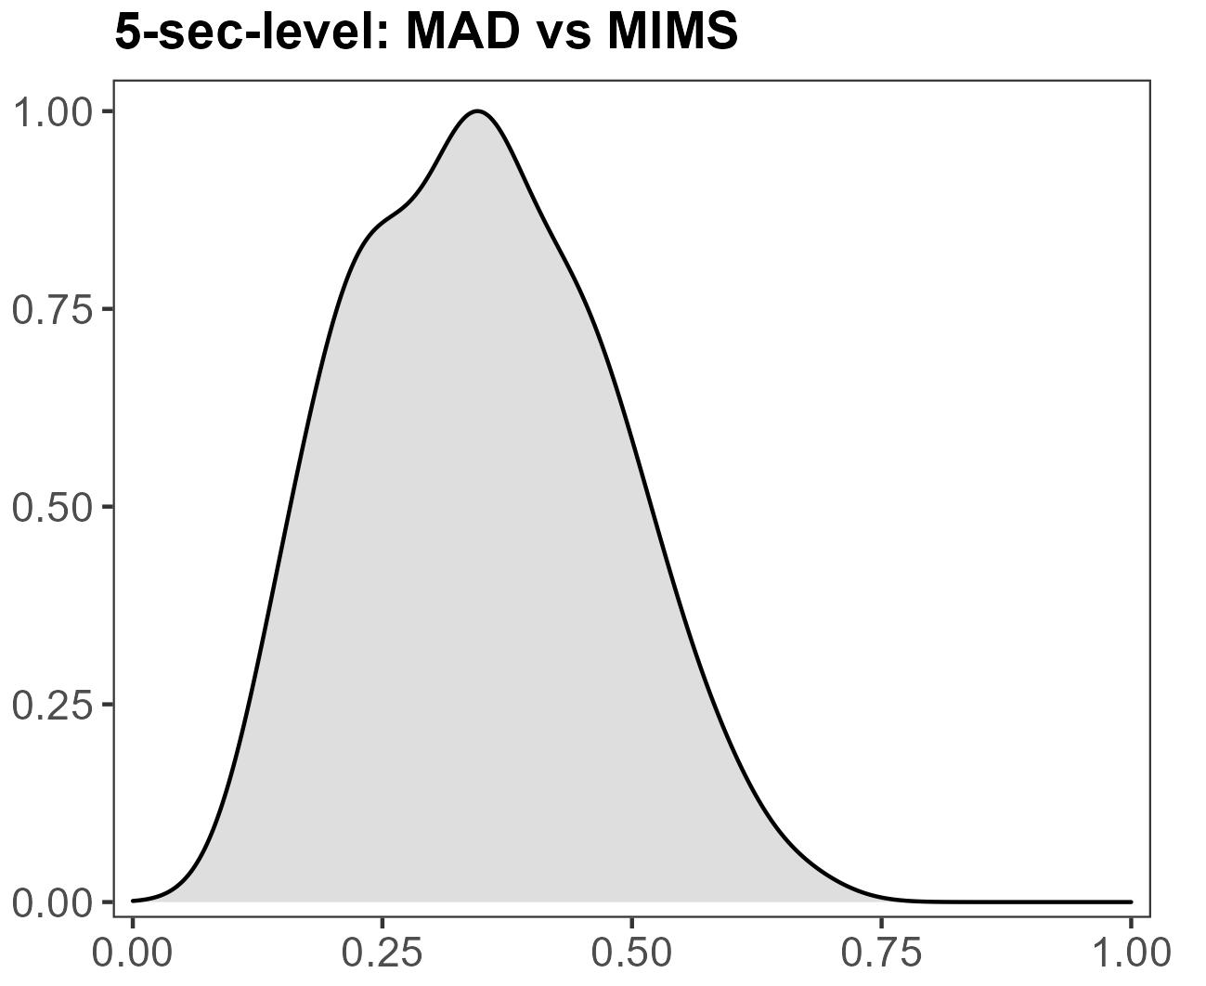
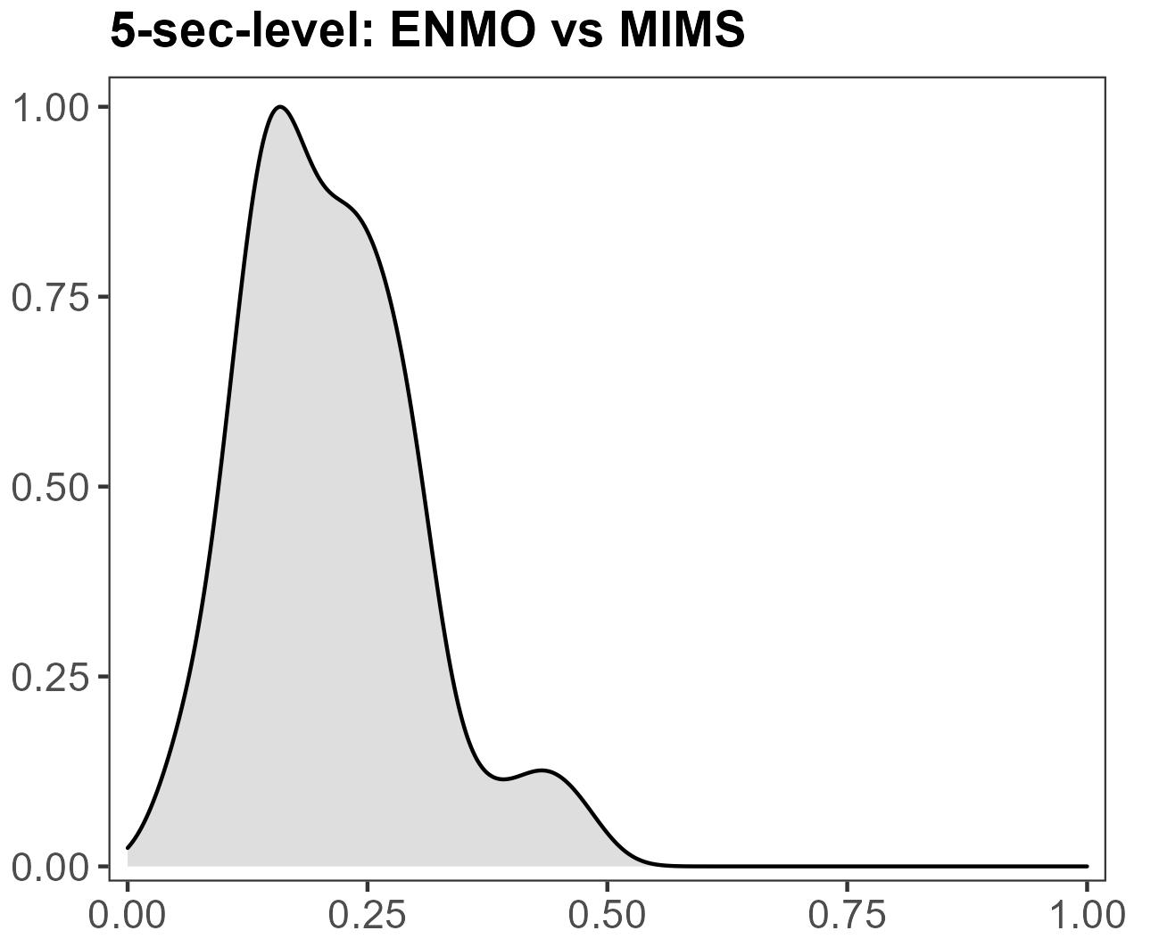
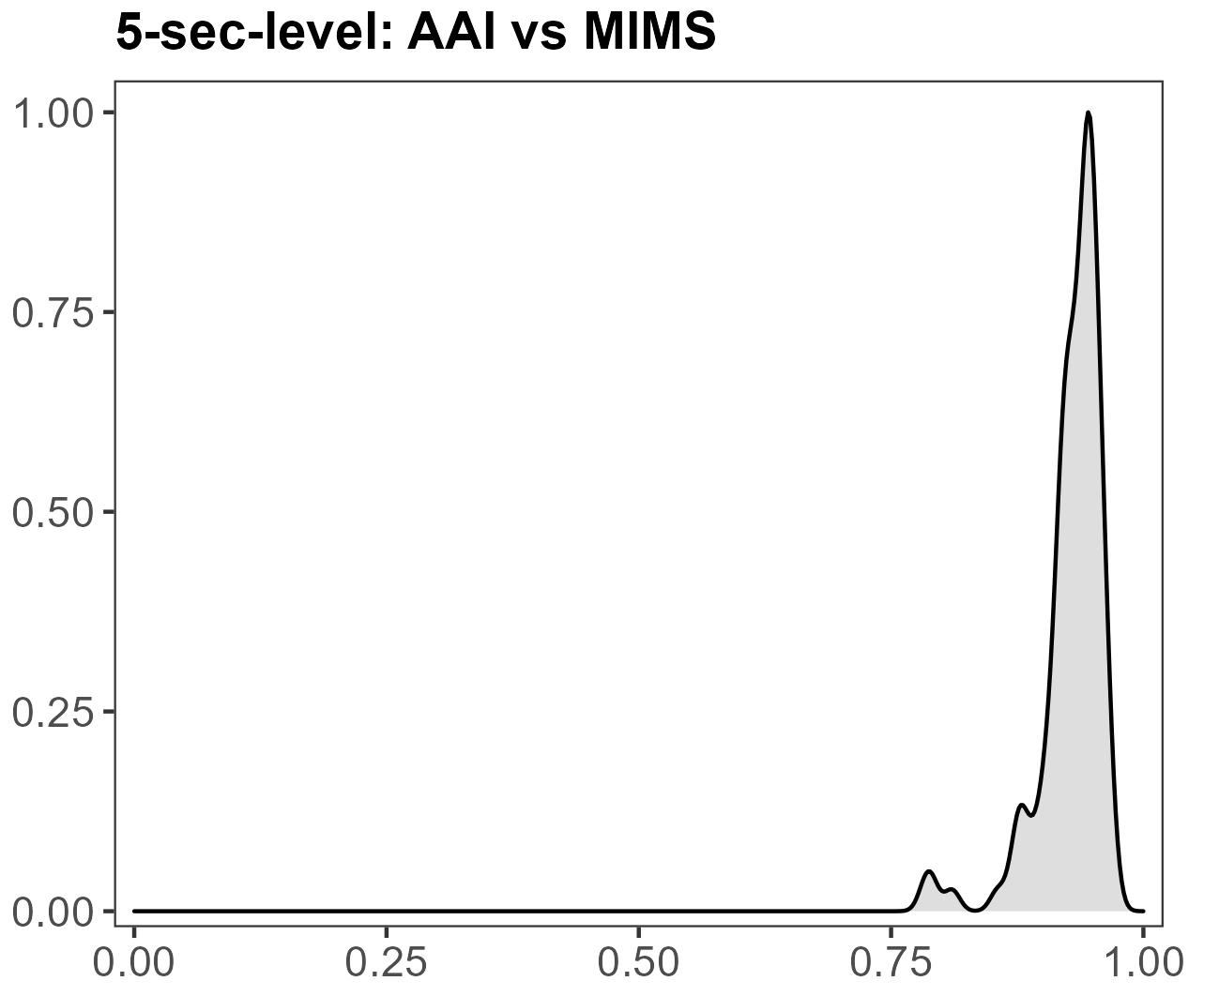
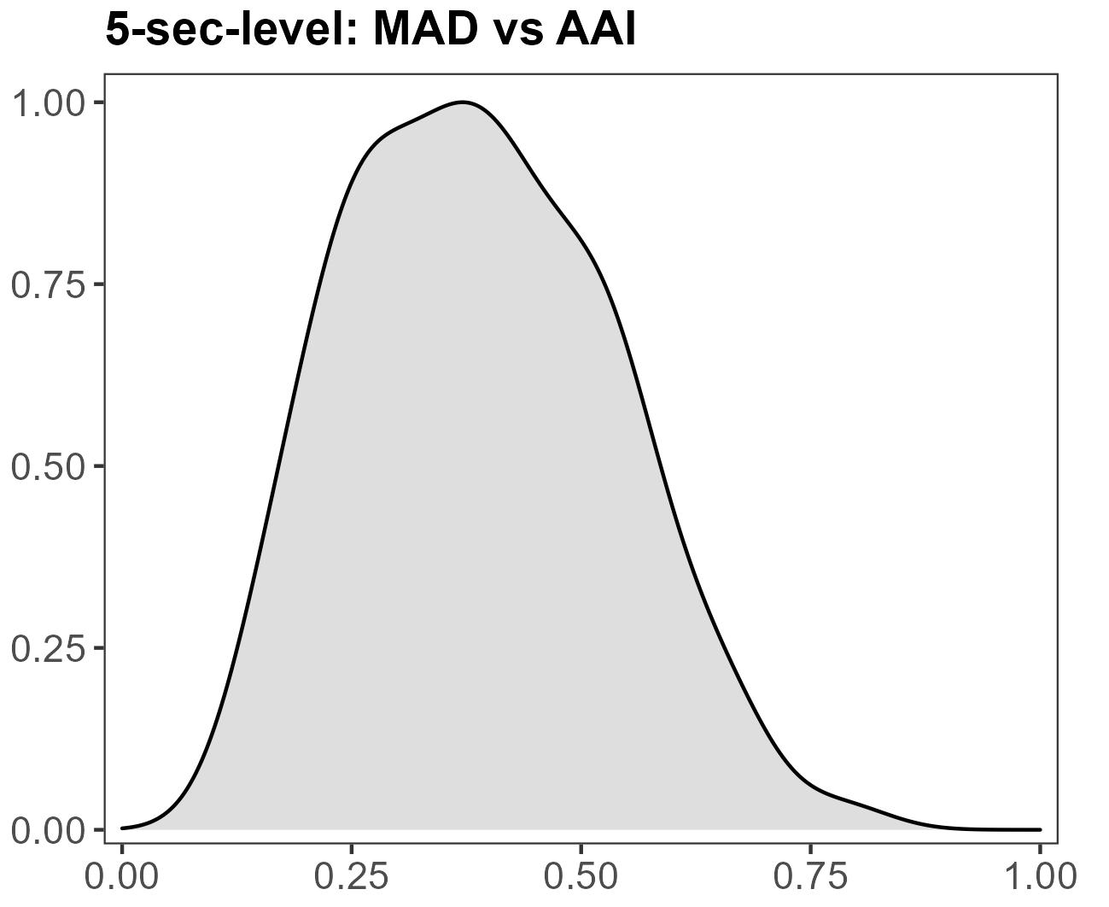
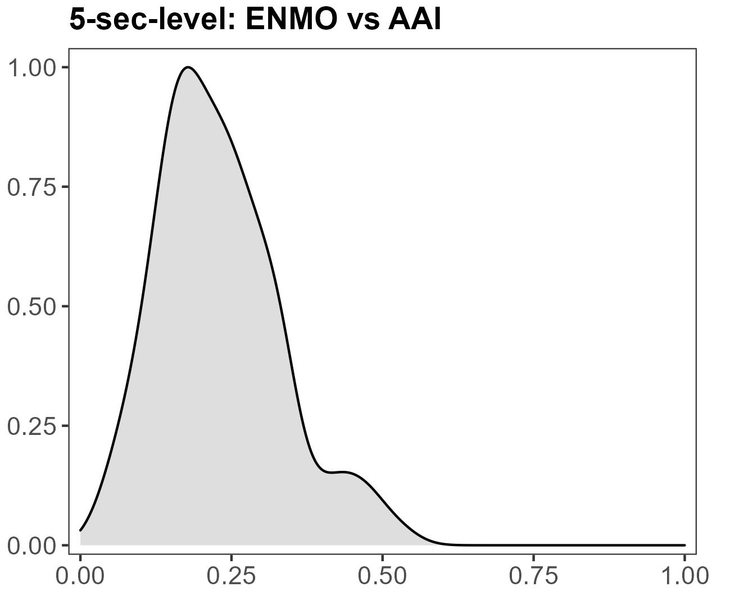
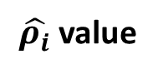
Supplement: Distribution of Correlations
Spearman correlations at the 5-sec-level
Density
$\hat{ρ_{i}}$ value

Slide 30
Supplement: Distribution of Correlations
Mean (SD) Spearman correlations
Counts | 0.15 (0.13) | 0.11 (0.12) | 0.42 (0.42) | 0.43 (0.44)
MIMS | 0.44 (0.15) | 0.28 (0.12) | 0.98 (0.02)
AAI | 0.46 (0.16) | 0.29 (0.13)
ENMO | 0.72 (0.14)
MIMS | 0.35 (0.12) | 0.21 (0.10) | 0.93 (0.03)
AAI | 0.39 (0.14) | 0.22 (0.11)
ENMO | 0.65 (0.14)
 | MAD | ENMO | AAI | MIMS
Minute-level data
5-sec- level data

Slide 31
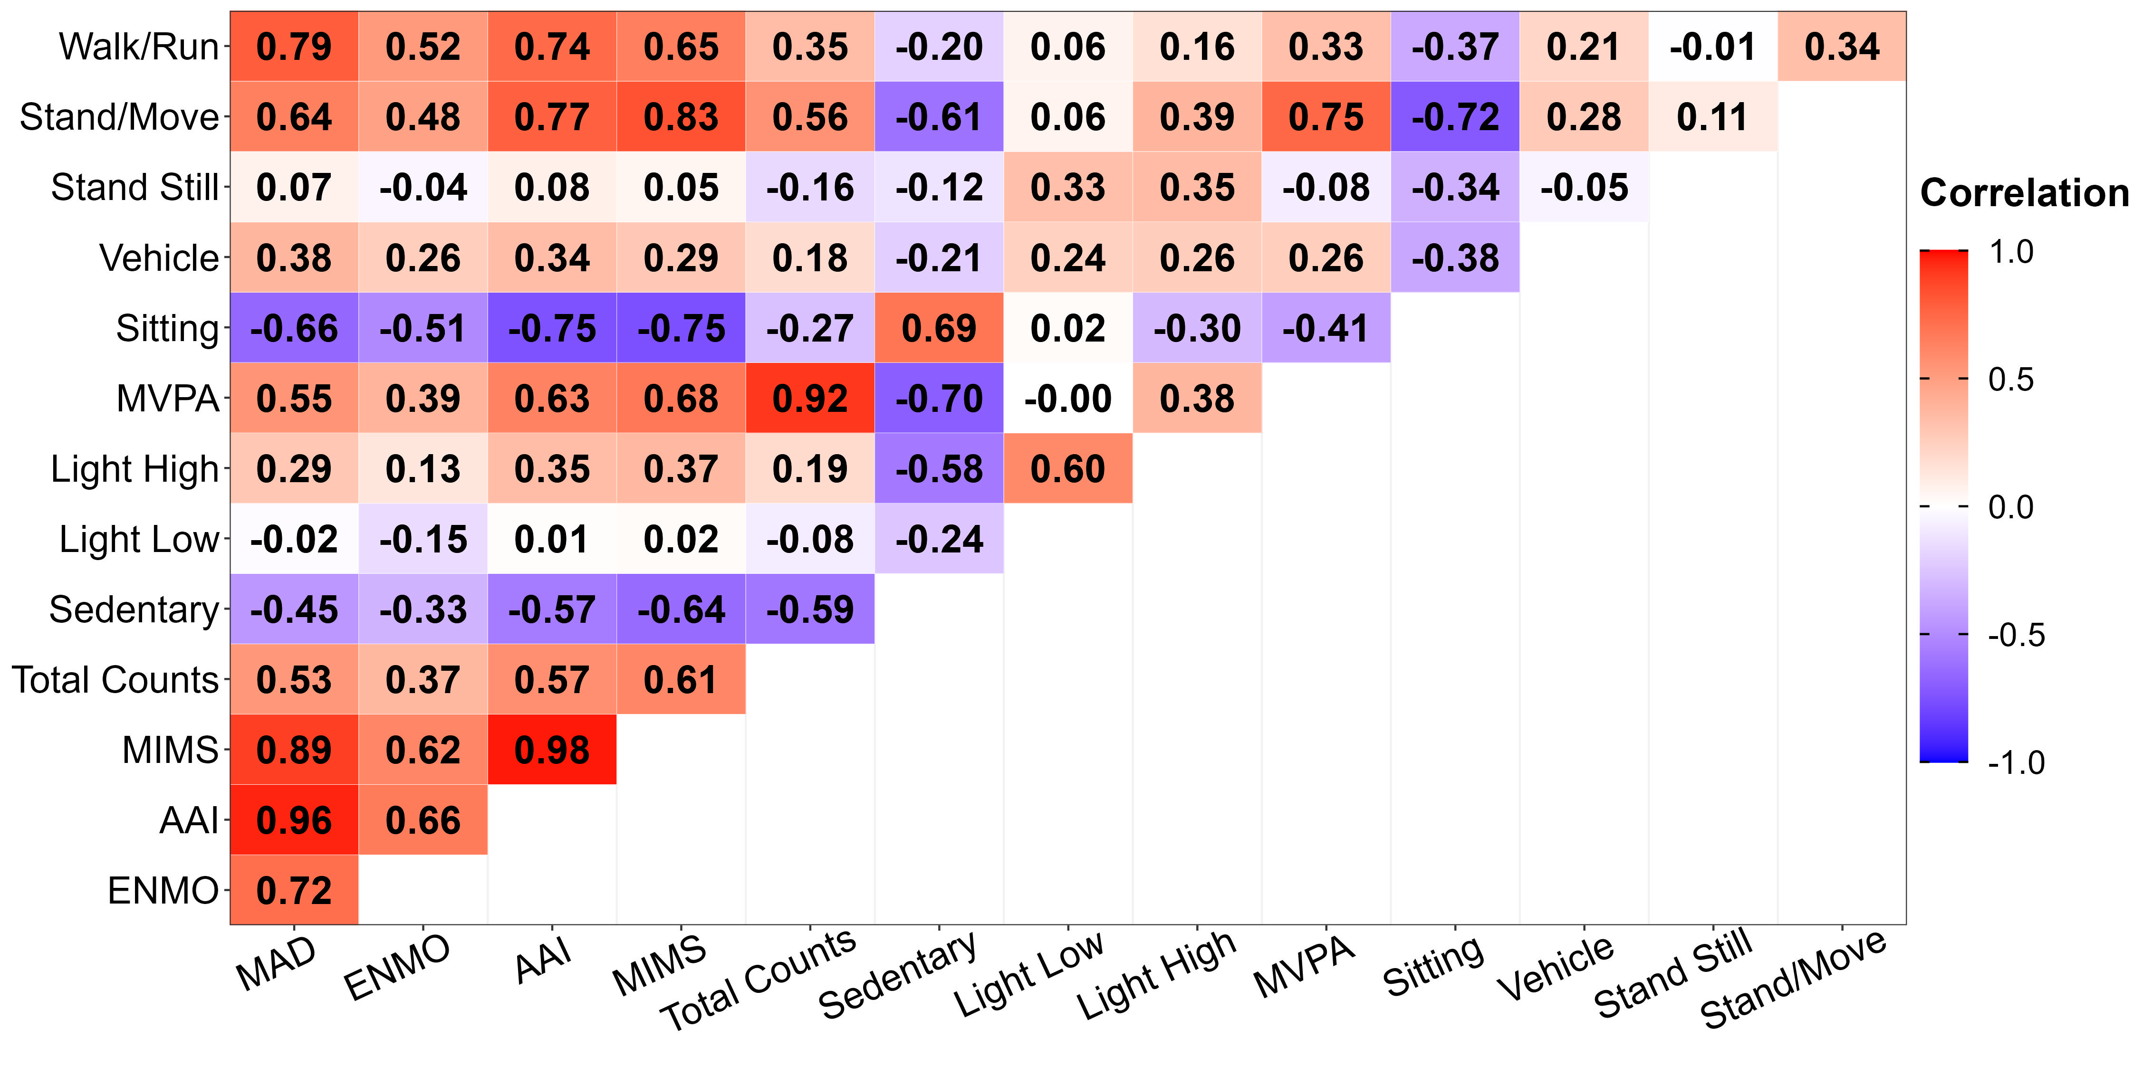
Supplement: Week-Level Correlations

Slide 32
Supplement: Pearson Correlations
Next slide: Correlation matrix with Pearson and Spearman correlations
Pearson – upper left of diagonal, value followed by ^{p}
Spearman – lower right of diagonal, value followed by ^{s}

Slide 33
Supplement: Pearson Correlations

Slide 34
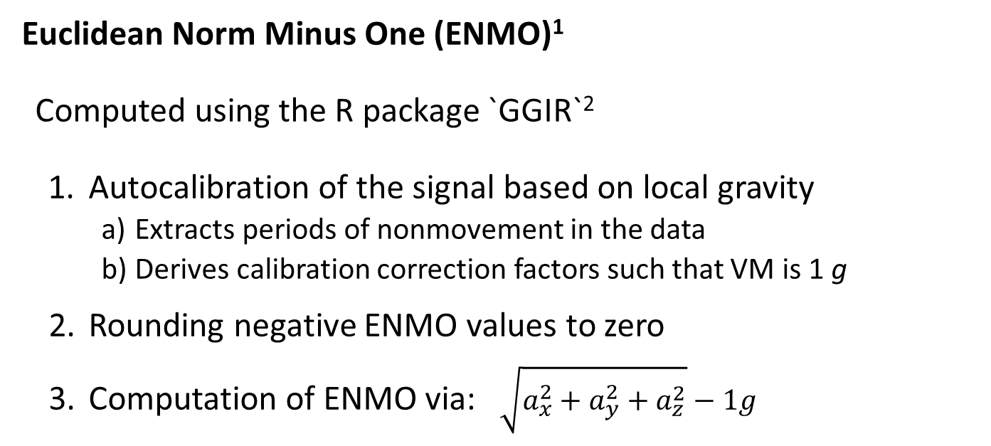

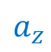
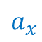
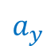
Supplement: ENMO
Euclidean Norm Minus One (ENMO)¹
Computed using the R package `GGIR`²
Autocalibration of the signal based on local gravity
Extracts periods of nonmovement in the data
Derives calibration correction factors such that VM is 1 g
Rounding negative ENMO values to zero
Computation of ENMO via: $\sqrt{a_{x}^{2}+a_{y}^{2}+a_{z}^{2}}−1g$
$$a_{y}$$
$$VM$$
$$a_{x}$$
$$a_{z}$$
¹ Van Hees et al., PLoS One 2013
² Migueles et al., J Meas Phys Behav 2019

Slide 35
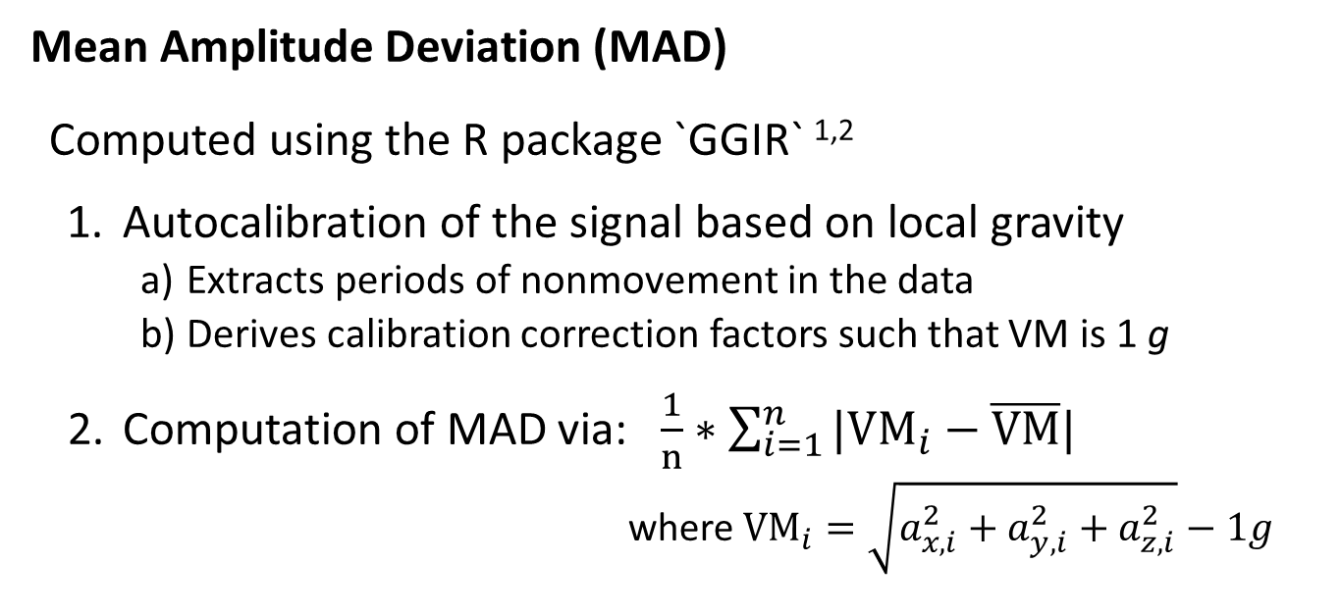
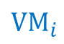
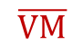
Supplement: MAD
$$VM_{i}$$
Mean Amplitude Deviation (MAD)
Computed using the R package `GGIR` ^{1,2}
Autocalibration of the signal based on local gravity
Extracts periods of nonmovement in the data
Derives calibration correction factors such that VM is 1 g
Computation of MAD via: $\frac{1}{n}∗\sum_{i=1}^{n}{|VM_{i}−\overline{VM}|}$
where ${VM}_{i}=\sqrt{a_{x, i}^{2}+a_{y,i}^{2}+a_{z, i}^{2}}−1g$
$$\overline{VM}$$
¹ Vaha-Ypya et al., Clin Physiol Funct 2015
² Migueles et al., J Meas Phys Behav 2019

Slide 36
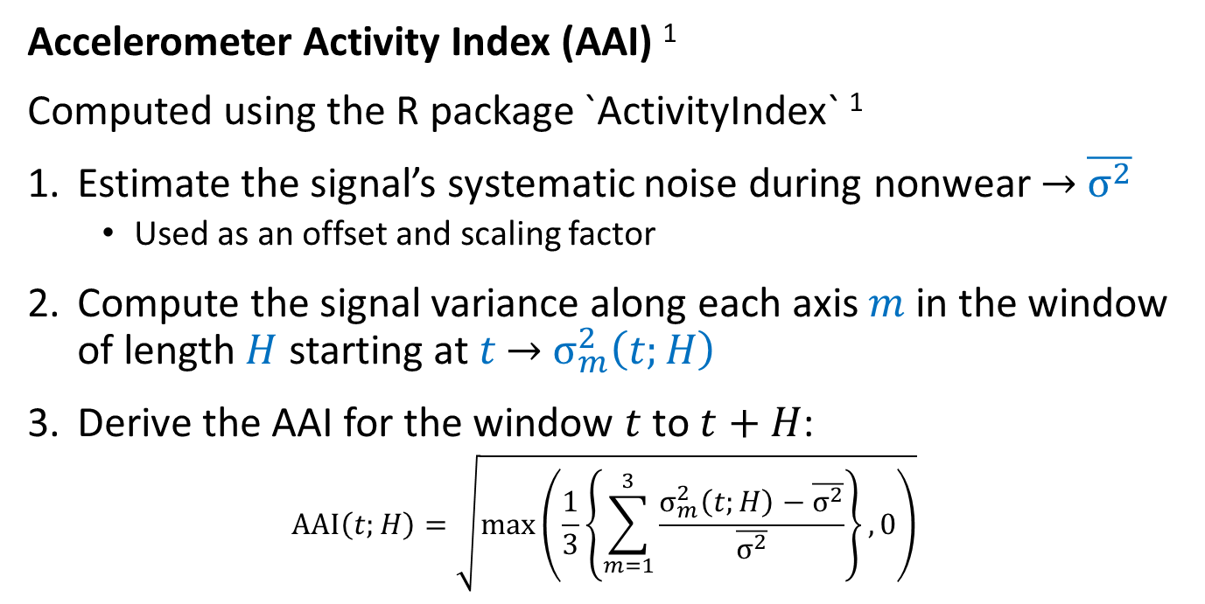
Supplement: AAI
Accelerometer Activity Index (AAI) ¹
Computed using the R package `ActivityIndex` ¹
Estimate the signal’s systematic noise during nonwear → $\overline{σ^{2}}$
Used as an offset and scaling factor
Compute the signal variance along each axis $m$ in the window of length $H$ starting at $t$ → $σ_{m}^{2}\left(t;H\right)$
Derive the AAI for the window $t$ to $t+H$:
$$\text{A}\text{AI}\left(t;H\right)=\sqrt{\max\left(\frac{1}{3}\left\{\sum_{m=1}^{3}{\frac{σ_{m}^{2}\left(t;H\right)−\overline{σ^{2}}}{\overline{σ^{2}}}}\right\},0\right)}$$
¹ Bai et al., PLoS One 2016

Slide 37
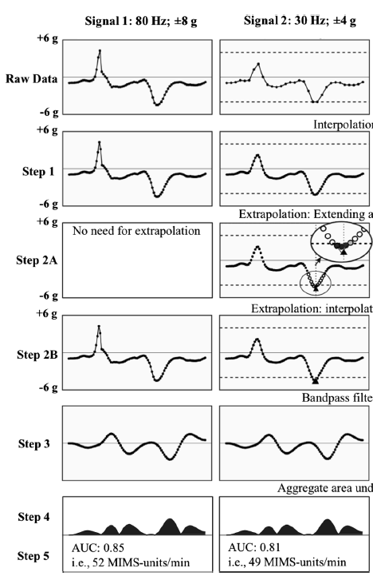
Supplement: MIMS
Monitor-Independent Movement Summary (MIMS) ¹
Computed using the R package `MIMSunit` ¹
Interpolate the signal by fitting a continuous function to the observed discrete points
Extrapolate the signal during periods where accelerations exceeded the device’s dynamic range, the maxed-out
Apply a bandpass filter to filters out signal artifacts and eliminate the gravity vector
Sum the signal AUC across axes within each epoch
¹ John et al., J Meas Phys Behav 2019

Slide 38
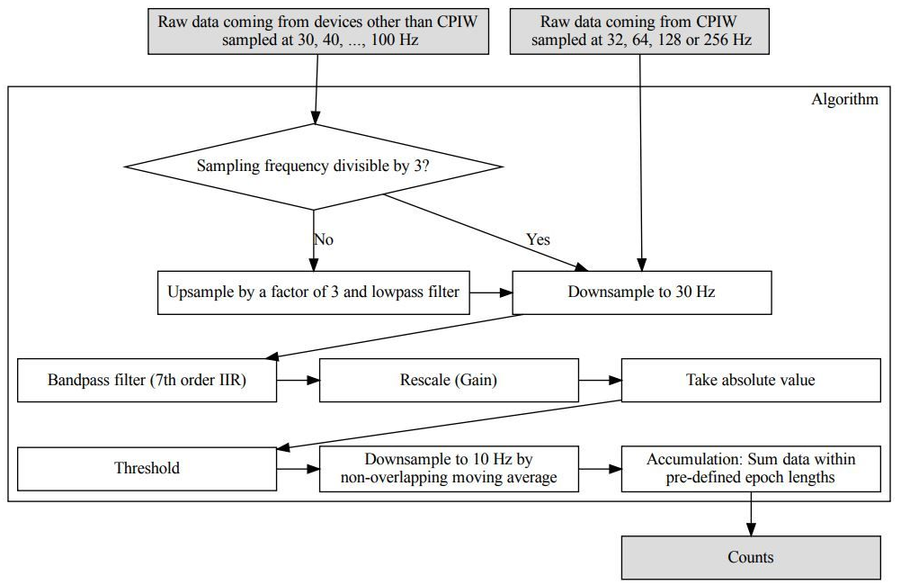
Supplement: ActiLife Count Algorithm
Neishabouri et al., 2022 (Preprint; Available on Research Square)

